Slide 1
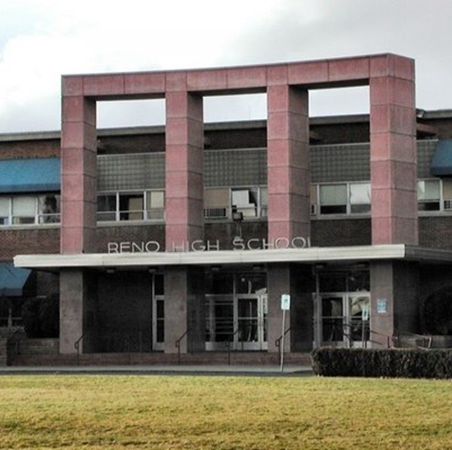
Reno High School
Welcome Class of 2029

Slide 2
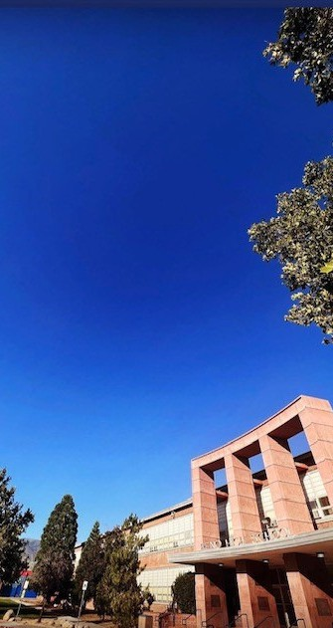
RENO HIGH SCHOOL FROSH PARENT NIGHT Class of 2029
Reno High School has a rich tradition of excellence in academics, activities, and athletics.We are a rigorous academic public institution that instills the culture of Respect, Honor, and Strength in everything we do. We want students to graduate as curious lifelong learners who can be positive contributors in the global community. We provide numerous clubs, arts, music, co-curricular programs and athletic clubs and teams for our students. We have high expectations with support and love for our Huskies.Welcome Parent Pups.
Principal Mike Nakashima

Slide 3





School Goals: Creating a safe and trusting community in the classroom and building for all students
Core credit attainment for all students

Slide 4


Online Registration Required annually. Sunday Messages-will begin late July.
Social Media:
IG @RHS_Admin
www.rhshuskies.comNND1.org - Calendar
.
Notes:
Student must have online registration completed to attend Frosh Day on Friday

Slide 5

Spring course requests to counselors.
Course request golden ticket required to get on Frosh Day Bus.
4 required classes, 3 elective choices-7 period day.
Frosh Day – February 7th
PE Clothes & Student ID’s issued 1st week of school.
www.registermy athlete.com required for athletic clearance for each season.

Slide 6






FEES
Fee information will come out later this summer
Be sure to pay any fall activity and sport fees right away as well as buy your yearbook early
Questions? Contact Kellie Carney kcarney@washoeschools.net
Notes:
New online payment program starting this summer
Be on the look out for more information

Slide 7


We R Present Campaign
Cell phone/earbud free classrooms-Instructional time, put away or check in with teacher

Slide 8

Attendance
Call in, prearrange, email teachers, use Canvas and Infinite Campus & don’t schedule vacations or appointments during finals.
Picking up early?
Send student with a note, please.

Slide 9
Restore at the Door
Discipline is dealt with in a restorative practices model through progressive discipline. We are partners with families. Fair, firm, consistent.

Slide 10


Supports
Counselors
Family Graduation Advocate Food Pantry
Mental Health Professional
Clinic
School Psychologist
Huskie House-Student Relations Office Student Voice Group
Clubs/Club Drive in the fall
College and Career Center-The Cube Administrative team
School Police
2 Campus Supervisors Upgraded surveillance cameras Crisis Alert System
Safety Plans
MTSS, PBiS, Safety and Culture Club Committees Safe Voice
Tutoring
Credit recovery
Special Education, 504 accommodation plans Grief supports
Dual Enrollment options, Advance Placement, Honors Elevator key if injured or cannot use stairs
Laptops available upon request Frosh Seminar

Slide 11

HIGH SCHOOL PARENT 101
R
H
Support your student with a quiet study area, encourage them to clean their room and not work from their cell phones. 2-3 hours of homework a night is routine. When absent, call the school, email teachers and/or use Canvas to stay up to date
S
Read the Sunday Messages! Make sure we have updated contact information. Use our website-lots of information there. We are your partners so communicate with us early and often. All parents are invited to Booster meetings! Get involved!!!
Check Infinite Campus Email teachers directly for updated information.
Encourage students to be advocates and email/speak with their teachers themselves. Work with us to stay on top of student progress and needs.

Slide 12
Schedule
7 period day with 50 minute periods Early Release Wednesday 1:45 Open campus-30 min lunch
students can go across the street at lunch to eat but many students stay on campus. Nothing good ever happens at Idlewild, fyi!
Transportation? Go to the WCSD Website to enroll. Buses pick up and drop off behind the IA Building off Foster Drive.
The building opens at 7:15am and we need students picked up by 3pm unless they have a tutoring, a sport or activity.

Slide 13


Fall Athletics Try-outs
IF your student is planning to try out for a fall sport, try- outs are in August. Make sure you complete the Register My Athlete online process and communicate with your coach and our Athletic Secretary, Mrs. Tina Rooker trooker@washoeschools.net. Don’t miss try-outs for a vacation. Cheer has try-outs this spring. Make sure you get information on cheer if needed.

Slide 14
Frosh Day
HAVE YOUR COURSE REQUEST PAPERWORK TO GET ON THE BUS. WE WILL HAVE 12 LARGE GROUPS ENGAGED IN VARIOUS TOURS AND ACTIVITIES FROM 10-1:15PM. LUNCH WILL BE PROVIDED BY PINOCCHIOS.

Slide 15
TONIGHT
WE HAVE VARIOUS DEPARTMENT REPRESENTATIVES AVAILABLE TO ANSWER QUESTIONS. WE HAVE COMPUTERS TO HELP YOU COMPLETE ONLINE REGISTRATION IF NEEDED. PLEASE SIGN UP WITH OUR RENO BOOSTER CLUB!

Slide 16
CULTURE
YOU ARE NOW PART OF THE HUSKIE FAMILY OF RESPECT HONOR STRENGTH, THE YELLOW TILED HALLS, THE ROCK, THE MIRROR! WE WORK HARD, WE ARE KIND AND WE ARE HUMBLE. THERE IS NO ENTITLEMENT AND NO COMPLACENCY. THE NEXT 4 YEARS WILL BE THE MOST FULFILLING AND THE MOST CHALLENGING FOR YOUR STUDENT AND YOUR FAMILY. WE TAKE THIS JOURNEY TOGETHER AND I CAN’T WAIT!

Slide 17

QUESTIONS?

Slide 18
Contacts
www.rhshuskies.com mnakashima@washoeschools.net renohighboosterclub@gmail.com 775-333-5050

